Slide 1
TradingWiz A ML Trading Algorithm Implementation
David Guerrero & Shubham Jaiswal
CSCI-6551 Prof. Breitinger

Slide 2
Running the Linear Regression algorithm on the stocks
Trading algorithms are an efficient method of automating transactions and computing technical analysis of financial stock data within a time series.
The purpose of Trading Wiz is to implement a Machine Learning (ML) trading algorithm that trains and tests a probabilistic mathematical model using historical stock data.

Slide 3
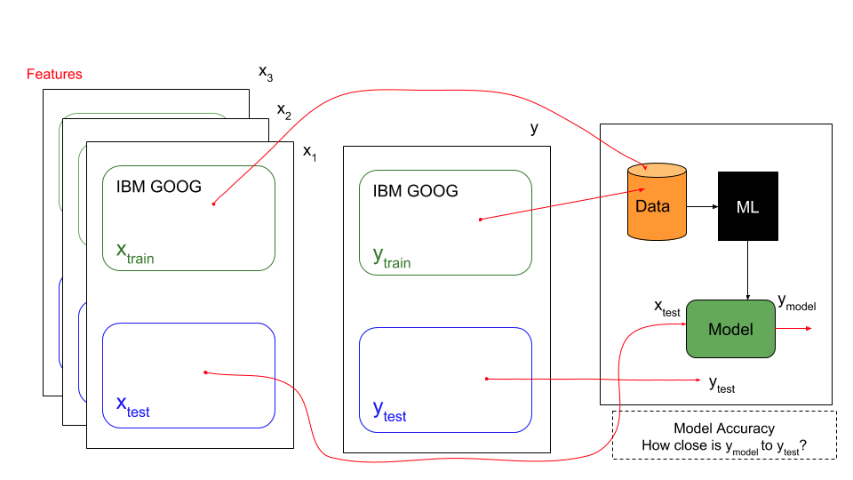

Slide 4
General Trading Algorithm
The overall application takes a set of historical stock data xtrain and ytrain ,runs it through a Linear Regression ML algorithm, this will generate a model.
Variable xtrain is a multi-dimensional representation of different features of certain ticker symbols (AAPL, GOOG, AMZN).
These features can be price change, momentum, or bollinger bands EXPLAIN THESE BELOW. ytrain is a set of stock price data for a given point of time.
The accuracy of the model can be tested by inputting a set of xtest data that produces a ymodel.
The closer this ymodel is to ytest the more accurate the model is. The data being used is based on linear time.
The older data is utilized to train and generate a model, the more recent data is used to test the model.

Slide 5
Architecture of TradingWiz
1. TradingWiz
2. DataImport
3. LinRegLeaner
4. PlotResults

Slide 6
TradingWiz
TradingWiz is the main module.
It calls the Learning module to predict prices of stocks using a Standard Average algorithm and an Exponential Moving Average.
It feeds data to Plotting module to display the graphs for each of the training algorithms overlaid with the median price data

Slide 7
DataImport
This module is used for importing stock data using the Pandas Data Reader which utilizes Yahoo Finance database for historical stock data.
A feature can be Open Price, High Price, Low Price, Closing Price, Adj. Close Price, and Volume. Returns a Pandas DataFrame.
These are all defined in the main application TradingWiz.

Slide 8
LinRegLearner
This module computes the mid_price
Sub-divides it into training and testing data
Scales and fits the train and test data accordingly
Smooths out train data to remove noise
This returns a tuple of scaled/smoothed trainData & scaled testData
This trainData and testData is combined
Dates are extracted from a dataFrame of stock data, it is used to compute a Standard Average and an Exponential Moving Average (EMA)

Slide 9
PlotResults
This module generates 3 plots. The first plot is the raw stock medium price for the full range of start to end.
The second generated plot overlays the actual stock price and the predicted stock price using a standard mean algorithm.
The third plot overlays the actual stock price and the predicted stock price when calculating the exponential moving average

Slide 10
Difficulties and Solutions
Learning to work with GitHub. Watched video tutorials.
Issues with installing the python libraries like Numpy and Pandas but later we downloaded Anaconda which comes with the inbuilt libraries.
Modularizing the code. Established the required classes to deploy a working application. Organized functions that work together and depend on each other and keep them within the same class. Develop a main module that runs the application.
Finding an algorithm that was accurate enough for the application while having an easy to understand mathematical expression

Slide 11
Demo and Questions

